Slide 1

G-20 HMR INTRA-COLLEGE
HACKATHON
27-28, MARCH 2023
Problem Statement Title: AGRICULTURE RELATED PROBLEMS
Team Name: TOXIC NATION
Team Leader Name: Priyanshu Singh kakusth
Mentor Name:
WE START THIS ON 24 MARCH 2023

Slide 2





PROBLEMS WE TRY TO RESOLVE DETAILS :
After extensive research and the assistance of agriculturalists, we encounter these agricultural problems.
TRY TO RESOLVE ALL THESE PROBLEMS WITH OUR APP
PROBLEMS
INTRODUCING OUR APP
Small and fragmented land holdings
Lack of Good Seeds, Manures, Fertilizers and Biocides
Proper Irrigation
Lack of mechanization
Soil erosion
Agricultural Marketing
Scarcity of capital
Pest and Plant Disease
Dependency of Monsoon
Lack Awareness of Govt. Scheme and Credit Facility.
These are among the major problems faced by Indian Agriculture.
CREATED BY:
THESE INFORMATION COLLECTED BY SAMEER (FARMER)

Slide 3


Idea/Approach Details
ISSUE OUR APP TRY TO RESOLVE
WEATHER REPORT
OBTAIN DIAGNOSIS
INSTANT DISEASE DETECTION
TREATMENT ADVICE
AGRITECH INFORMATION
GET ONLINE ADVICE FROM AGRICULTURISTS
DISEASE ALERTS
PREVENTIVE MEASURES
CALCULATING FERTILIZER BASED ON PLOT SIZE
BEST PRICE DEALS AND NEAR MANDI PRICING
SOIL TEST AT YOUR DOOR

Slide 4


DESCRIBE YOUR TE﻿CHNOLOGY STACK HERE:
USING AGRI-TECH
TECHNLOGY
KRISHI YOGI is a mobile crop advisory app for farmers, extension workers and gardeners. KRISHI YOGI was developed by TEAM TOXIC NATION a startup. Our app claims to provide Weather Prediction, Obtain Diagnosis, Instant Disease Detection, Treatment advisory, Agriculture information, Online Advice from Agriculturists, Disease alerts, Preventive Measures, Calculating fertilizer based on plot size, Best price deals, mandi prices update, soil test at your door diagnose, pest damages, plant diseases and nutrient deficiencies affecting crops and offers corresponding treatment measures
We Currently have an in-built library in KRISHI YOGI for farmers to use to diagnose their crops.

Slide 5
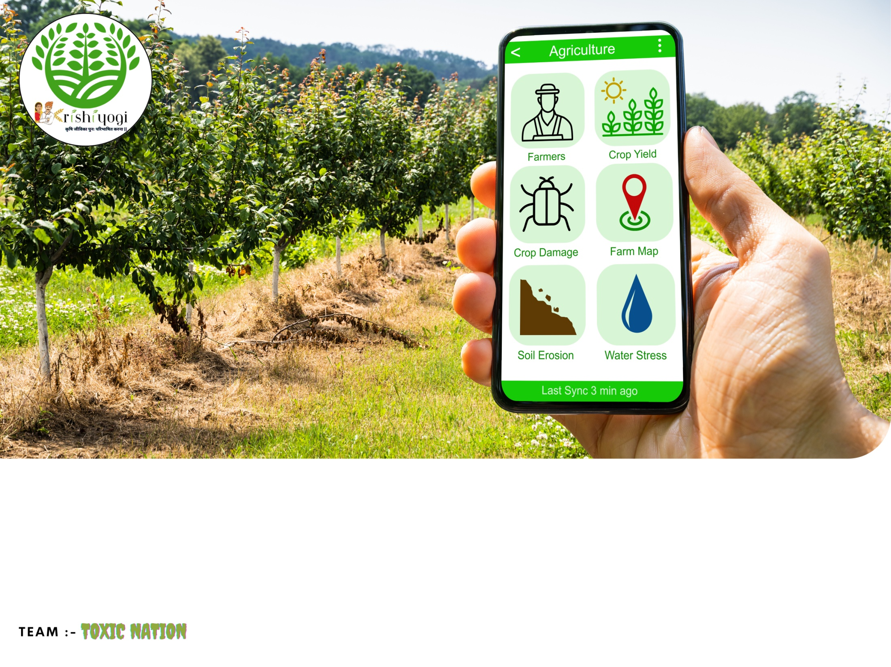
CHOOSE YOUR LANGUAGE
CREATE ACCOUNT
SELECT YOUR SERVICE
OUR TARGET TO RESOLVE ALL FARMER RELATED PROBLEMS
WE ARE CURRENTLY AVAILABLE IN HINDI / ENGLISH BOTH LANGUAGES !
EASY TO USE BASIC INTERFACE THAT ALL CAN GET,
YOU CAN SELECT SERVICES AND PROCEED
IT PROVIDES COMPLETE INFORMATION ON CROP PRODUCTION, CROP PROTECTION, SMART FARMING WITH AGRICULTURE, AND ALLIED SERVICES. IN ADDITION TO BEING AN INFORMATION PORTAL, KRISHIYOGI IS ALSO AN ONLINE MARKETPLACE FOR BRINGING IN FARMERS, AGRI INPUT, RETAILERS & FULFILLMENT SERVICES ON A COMMON DIGITAL PLATFORM

Slide 6

Team Member Details
Sr. No. | Name of Team Member | Course (B.Tech ): | Year | Position in team (Team Leader, Front end Developer, Back end Developer, Full Stack, Data base management etc.)
1 | PRIYANSHU SINGH KAKUSTH | CSE B 1 SHIFT | 1 | TEAM LEADER , FRONT END DESIGNS
2 | ANANYA BAGHEL | IT DEPARTMENT | 1 | CONTEXT DESIGNING DATA MANAGEMENT
3 | AMAN KUMAR | CSE B 1 SHIFT | 1 | BACK END DEVELOPER FULL STACK
Team Member Details
Sr. No. | Name of Mentor | Department
1

Slide 7



THANKS FOR YOUR TIME

